Slide 1
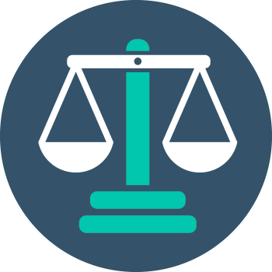


Ethics in IT
Class IX
lab 4

Slide 2

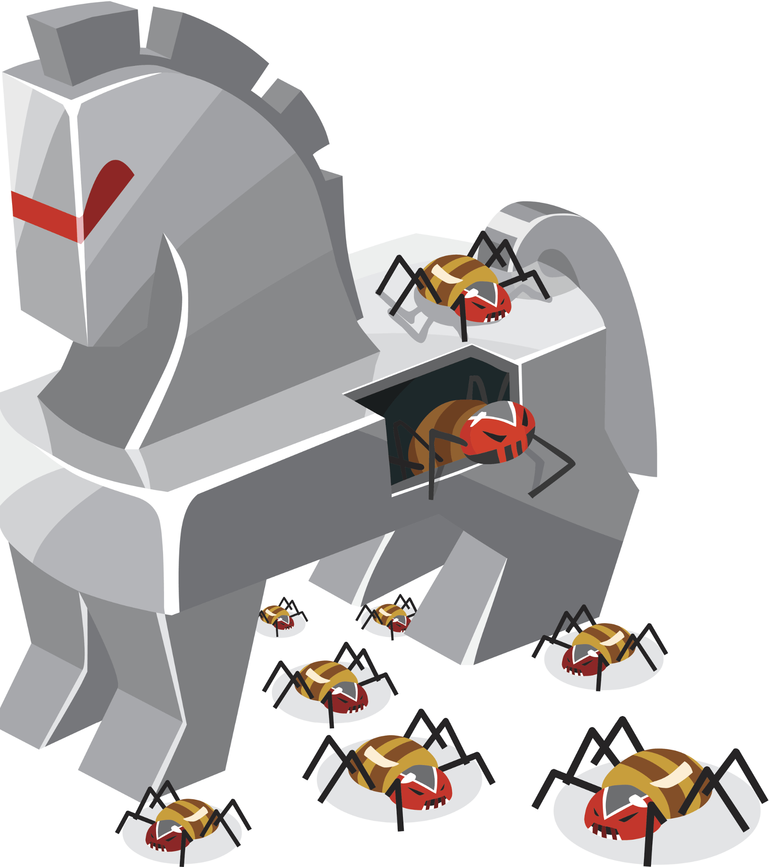
Trojan Attacks
trojan, is any malicious computer program which misleads users of its true intent.

Slide 3
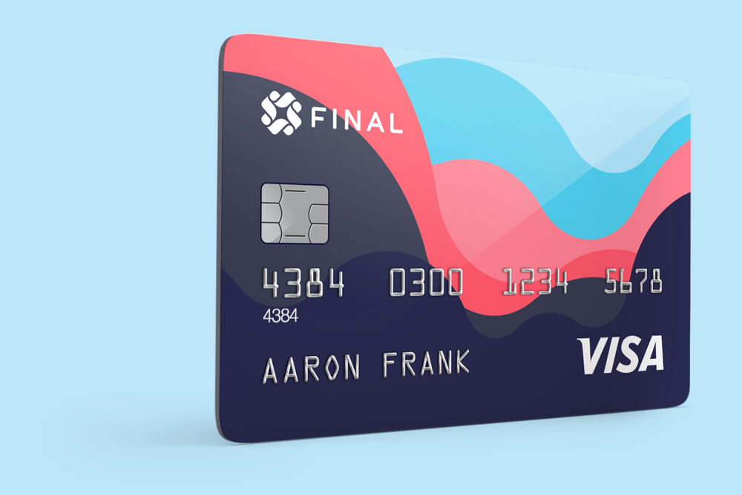
Steal Financial Data
Trojans can steal all your financial data like bank accounts, transaction details, PayPal related information

Slide 4
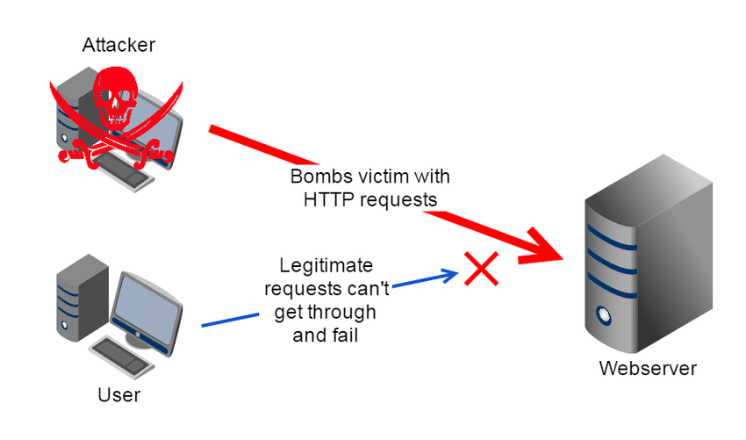
Denial of Services
Trojans can use the victim computer to attack other systems using Denial of Services

Slide 5
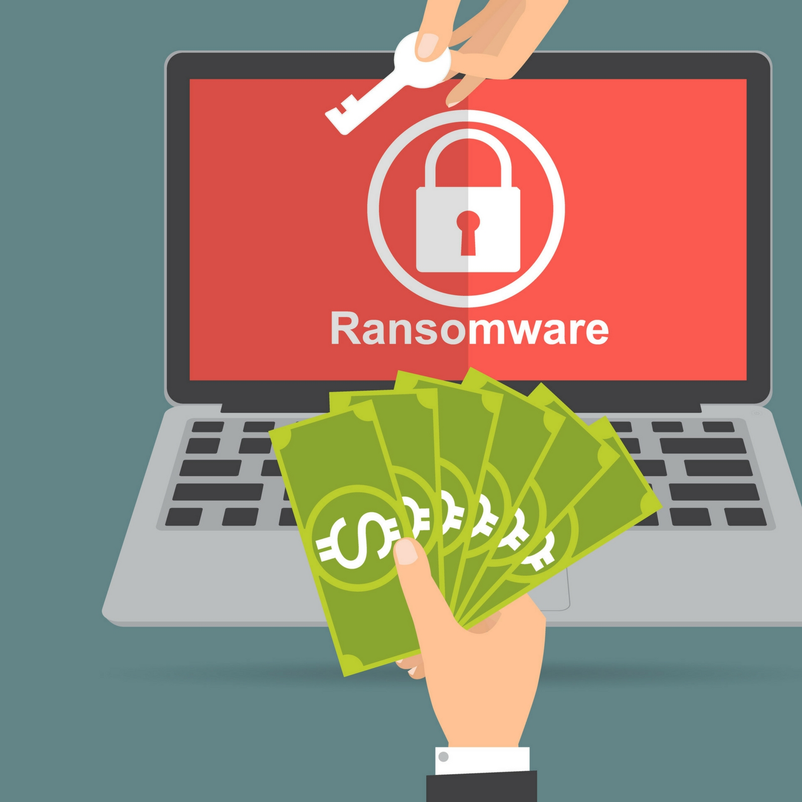
Ransome Trojan
Trojans can encrypt all your files and the hacker may thereafter demand money to decrypt them

Slide 6
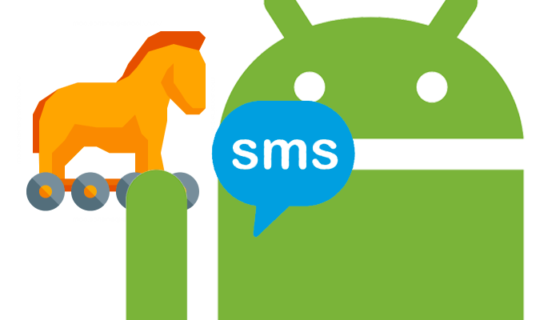
SMS Trojan
They can use your phones to send SMS to third parties

Slide 7
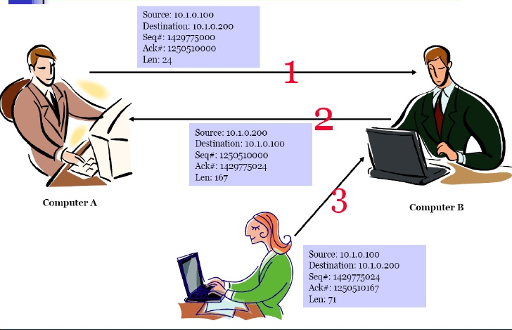
TCP/IP Hijacking
when an authorized user gains access to a genuine network connection of
another user

Slide 8
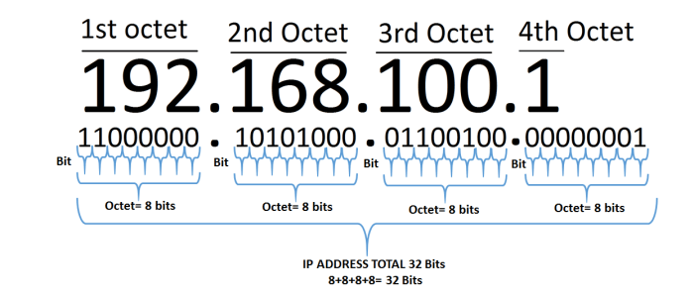
IP Address

Slide 9
IP Address

Slide 10
